Slide 1
FACE LIVENESS DETECTION
Under The guidance of Prof G.C.Nandi
Group Members :
Shivam Aggrawal (IIT2011158)
Shubham Agarwal(IIT2011165)
Shantanu Agrawal(IIT2011172)

Slide 2
How face authentication works ?

Slide 3
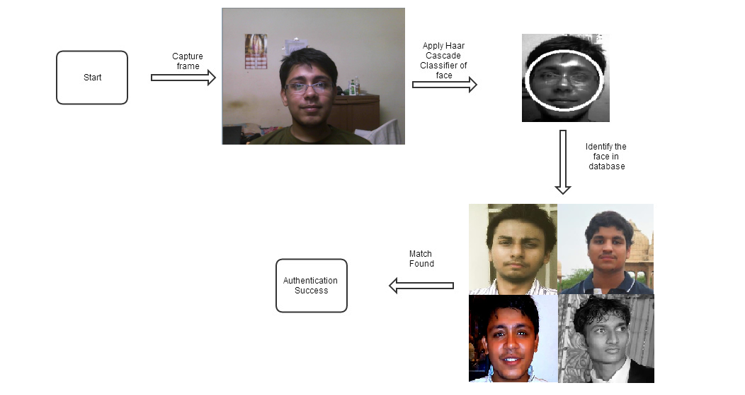
PROBLEM DEFINITON

Slide 4
PROBLEM DEFINITON
Face authentication available nowadays can easily be spoofed using commonly available technologies like
Photographs
Digital image
Videos
In the social media era, users’ faces are often available online. Highly contrasted photographs of user’s faces such as pictures on Facebook, Twitter, and LinkedIn etc. can be taken even without the knowledge of the user.

Slide 5
PROBLEM DEFINITON
Faces should be considered public knowledge, which means face authentication lacks a secrecy component. Secrecy is the strength behind passwords and PINs; to be secure, it may be something that face authentication must incorporate.
To defend against these vulnerabilities we propose a face authentication system that includes user friendly challenges.

Slide 6
Face authentication spoofed using photograph

Slide 7
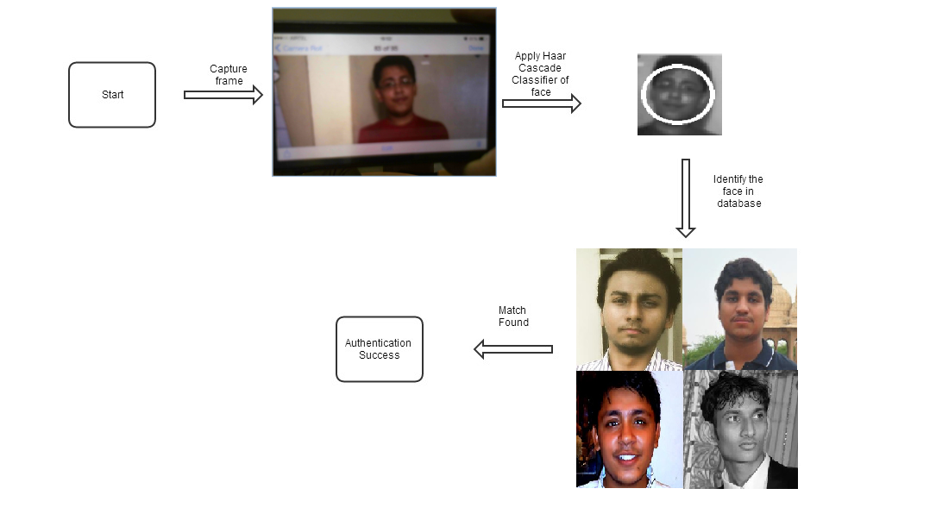

Slide 8
LITERATURE SURVEY
Photos taken in conditions similar to users’ enrolment conditions most likely result in successful logins[1], but not always. Such Face Authentication Systems can be breached easily using widely available photographs of the users’.
Some companies provide such systems like Dell, HP, Lenovo and Toshiba. According to a survey, HP systems were easily spoofed using still images while others have some resistance to it.

Slide 9
PROPOSED SOLUTION
Challenge Response Mechanism
Mechanism in which one party presents a question ("challenge") and another party must provide a valid answer ("response") to be authenticated.
The users are required to look into a certain direction, which is randomly chosen by the system.
By estimating the eye movements, the system verifies the user's response to the direction challenge. The movement estimation is based on detection and subsequent tracking of suitable features.

Slide 10
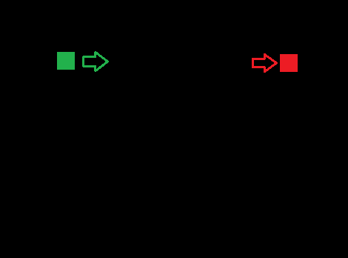
PROPOSED SOLUTION
Recognize the face.
Detect the position of the eyeballs.
Throw the randomly generated challenge prepared as shown in the figures.
Figure : 1st random pattern generated

Slide 11

PROPOSED SOLUTION
Record the response of the user for that challenge by detecting the coordinates of the new eyeball position.
Get the relative difference in previous and new positions of eyeball.
If the response is as expected, authentication is successful.
Figure : 2nd random pattern generated

Slide 12
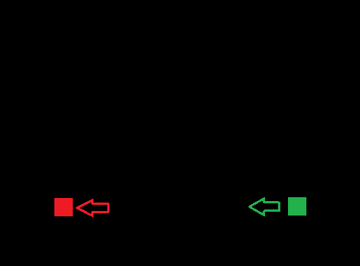
PROPOSED SOLUTION
Otherwise, it is identified that user is not live.
Hence, cannot be authenticated.
Figure : 3rd random pattern generated

Slide 13






Proposed Solution
Difference is
9px-10px
Difference is
10px-11px
Difference is
8px-9px
Difference is
9px-10px

Slide 14
FACE LIVENSS DETECTION

Slide 15
FACE AND EYE DETECTION
Detecting faces and eyes using Haar Cascade Classifier for faces and eyes
Applying Hough transformation for detecting cornea so as to track the eye movements
Extracting eyes from faces by cropping out the probable region for eyes in the face, when accuracy is not found in case when we have used Haar classifier for eyes.

Slide 16
FACE AND EYE DETECTION
Steps Involved :
First detect the face using the Haar classifier of face from the video so obtained by the web camera
Then crop the probable eye region of the face using estimated proportion
Then detect the left and the right eye of the detected face.
Then use Hough transformation for detection the cornea of both the eyes separately
Draw a circle around the cornea from the center coordinates and the radius so obtained from the transformation.
Track the movement of eye and synchronize it with the challenges thrown to the system.

Slide 17
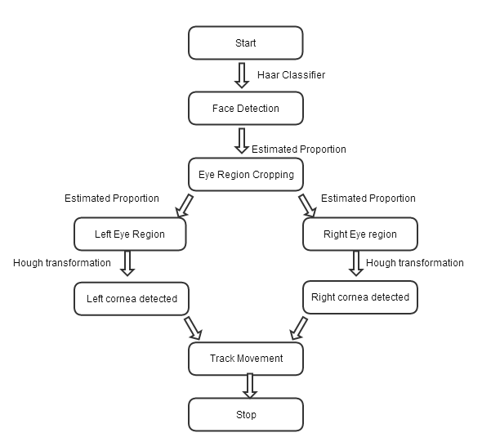

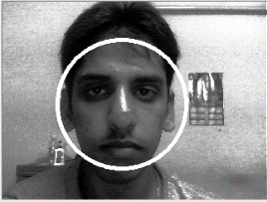



Slide 18
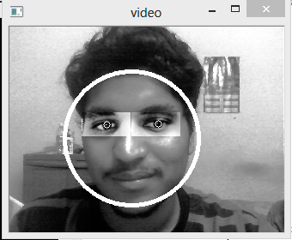


SNAPSHOTS
Figure : Showing the face recognition along with the cornea detected

Slide 19
MOVEMENT SYNCHRONIZATION
1) The person see to its top left most point on screen and presses a key(space bar) to indicate the program about the left extreme value at that distance.
2) The person then see to its bottom right most point on screen and presses a key to indicate the program about the right extreme value at that distance.

Slide 20
MOVEMENT SYNCHRONIZATION
3) After that two point would be generated randomly on the screen – one of green colour and another of red colour. Person has to look from the green point generated on the screen to the red one. If system could verify the motion, he has passed this step test. Otherwise either person have to try again or he could not be authenticated.
4) The step four is repeated random number of time

Slide 21
Figure : The person see from green do to the red dot

Slide 22
Figure : As the person see the red point it becomes green and a new random red point is generated on the screen

Slide 23
TIMEOUT MECHANISM
A timeout mechanism is then used to further prevent the system from verification form videos.
We have taken time 2s, in this very time person must see from the green point to the red point.

Slide 24
TIMEOUT MECHANISM
If he/she is not able to complete the task in this 2 second interval then the person is not live, otherwise he is said to be live person.
The process of generation of point is repeated and if the person passes all these live test correctly then he can access the system.
Otherwise he cannot access the system.

Slide 25
RESULTS
We have successfully verified liveness of the face using web camera using challenge response mechanism. These challenges are user friendly can be taken as a simple eye game.
We have not used any extra high-tech equipment for detecting the eyes (Web camera of simple laptop) and detected the liveness using eye movements with response to the point genrated on the screen.

Slide 26
LIMITATIONS
The position of the head should be kept constant.
The person should be seated between an optimum range (not far from 40 cm) for best results.
The person should be able to track the point in 2s .
The person should be in proper illumination conditions.

Slide 27
REFRENCES
[1] A. F. Abate, M. Nappi, D. Riccio, and G. Sabatino. 2d and 3d face recognition: A survey. Pattern Recognition Letters, 28(14):1885–1906, 2007.
[2] Z. Zhu, Q. Ji. “Real-time eye detection and tracking under various light conditions.” ACM papers.2001
[3] A. Haro, M. F. “Detecting and tracking eyes by using their physiological properties, dynamics, and appearance.” Proc. Of IEEE Conf. on CVPR, 2000.
[4] T.Kawaguchi, D.Hikada, and M.Rizon, “Detection of the eyes from human faces by Hough transform and separability filter,” Proc. of ICIP, pp.49-52, 2000.
[5] D.Reisfeld, H.Wolfson, Y.Yeshurun, “Context free attentional operators: the generalized symmetry transform”, Int.Journal of Computer Vision, 1995.
[6] S.Baskan, M. M. B., V.Atalay, “Projection based method for segmentation of human face and its evaluation”. Pattern Recognition Letters 23, 1623-1629, 2002.

Slide 28
THANK YOU

